Slide 1
Java Programming Language
- Vishnu Priya

Slide 2
What is Java?

Slide 3
Why Java?

Slide 4
Why all opt TechRel Solutions?

Slide 5
About the course
Course Goals
Course Map
Course Contents

Slide 6
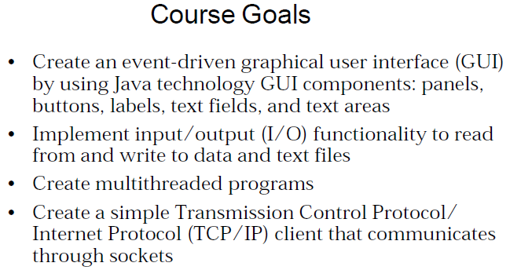

Slide 7
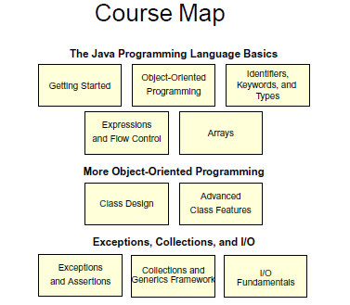

Slide 8
Course Contents
Java Basics
OOPs Concepts
Language Basics
Classes and Objects
More on Classes
Inheritance
Interfaces
Numbers
Strings
Generics and Packages
Exceptions
File Operations
Collections Intro
List Interface
Set Interface
Map Interface
List Implementation
Set Implementation
Map Implementation
Multi Threading

Slide 9
Applications of Java
Desktop GUI Applications
Mobile Applications
Embedded Systems
Web Applications
Web servers and Application servers
Enterprise Applications
Scientific Applications

Slide 10
Conclusion

Slide 11
Any Queries? Please reach me via mail id : karanamvishnupriya7@gmail.com

Slide 12
Thank you

